Slide 1
Studio Shodwe
Home
Profile
Our Contact
DATA-DRIVEN ANALYSIS OF PROFITABILITY AND FOOD WASTE IN A ROTATING MENU SYSTEM: EVIDENCE FROM A SMALL-SCALE FILIPINO EATERY
John Vernon B. Baldeo

Slide 2
Studio Shodwe
Home
Profile
Our Contact
INTRODUCTION

Slide 3
Studio Shodwe
Home
Profile
Our Contact
Abstract
This study evaluates the profitability and waste patterns of a repeating menu system in a Filipino eatery using 30 days of operational data. Descriptive analytics and statistical tests revealed significant profit differences across dish categories, with fish and vegetable dishes generating the highest returns while chicken dishes showed the greatest waste and lowest profitability. A moderate negative correlation between waste rate and profit confirms that overproduction reduces earnings. The findings demonstrate that simple data-driven analysis can improve menu planning, reduce waste, and enhance operational efficiency in small food service businesses.

Slide 4
Studio Shodwe
Home
Profile
Our Contact
Objectives
  Evaluate the operational performance and profitability of a repeating menu system in a small eatery.
  Analyze profitability across dish categories and individual menu items.
  Examine food waste patterns and their impact on financial outcomes.
  Determine whether mean profit differs significantly among dish categories.
  Assess the relationship between waste rate and profit.
  Evaluate consistency and variability in dish-level profitability.
  Provide data-driven insights to improve menu planning and reduce financial risk.

Slide 5
Studio Shodwe
Home
Profile
Our Contact
METHODOLOGY

Slide 6
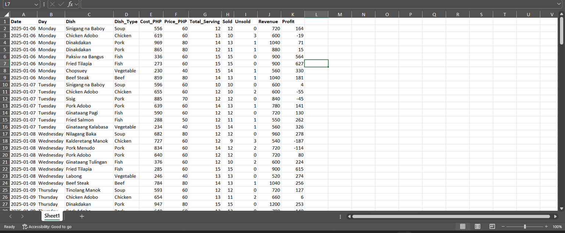
Studio Shodwe
Home
Profile
Our Contact
  Data Collection:
    30 days of manually recorded production and sales data from a Filipino eatery with a rotating menu.
  Variables Tracked:
    Dish type, cost, price, servings prepared, sold, unsold, revenue, profit, and waste rate.

Slide 7

Studio Shodwe
Home
Profile
Our Contact
Data Processing
  Verified data completeness and consistency.
  Computed key metrics: revenue, profit, and waste rate.
  Engineered additional features (e.g., profit margin, waste percentage, dish category indicators) to support analysis.
  Screened for outliers and unusual values.

Slide 8
Studio Shodwe
Home
Profile
Our Contact
  Analysis Techniques:
    Descriptive analytics (aggregation, ranking, visualization)
    Waste and profit trend analysis
    Category-level performance comparison
  Statistical Tests:
    One-way ANOVA to detect profit differences across dish categories
    Pearson correlation to assess the relationship between waste rate and profit

Slide 9
Studio Shodwe
Home
Profile
Our Contact
RESULTS AND DISCUSSION

Slide 10
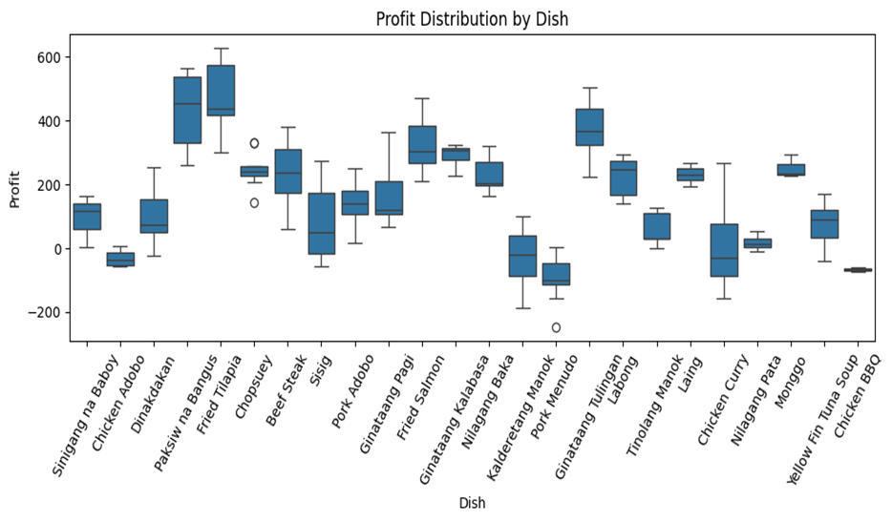
Studio Shodwe
Home
Profile
Our Contact
Distribution of Profit

Slide 11
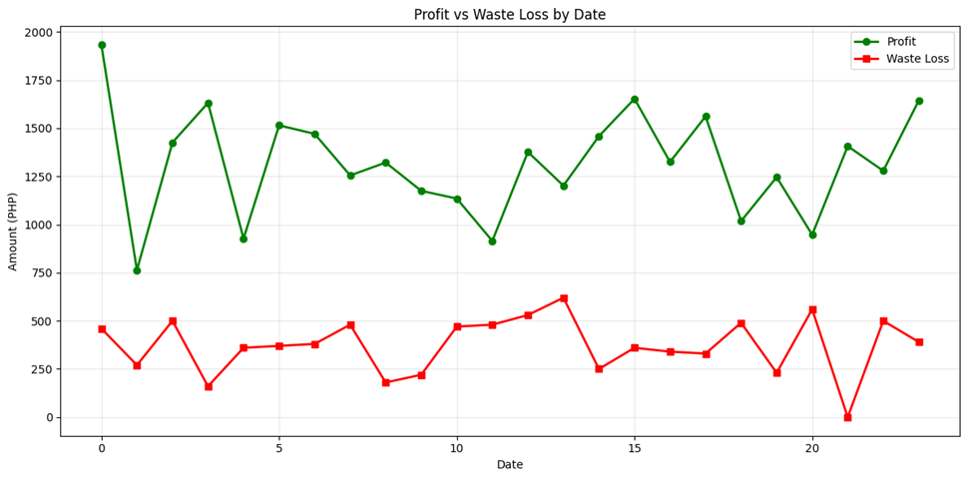
Studio Shodwe
Home
Profile
Our Contact
Daily Profit and Waste Trend

Slide 12
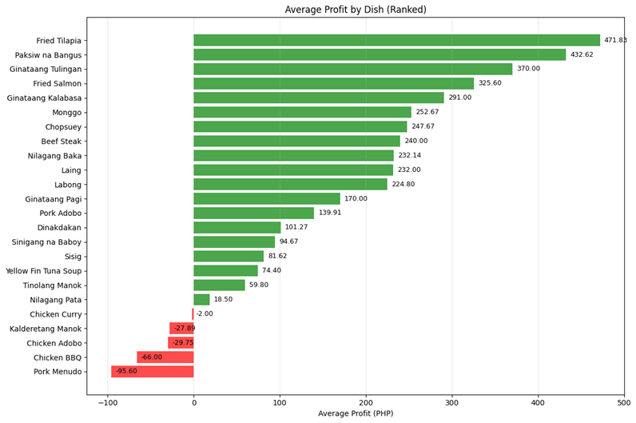
Studio Shodwe
Home
Profile
Our Contact
Profit by Dish

Slide 13
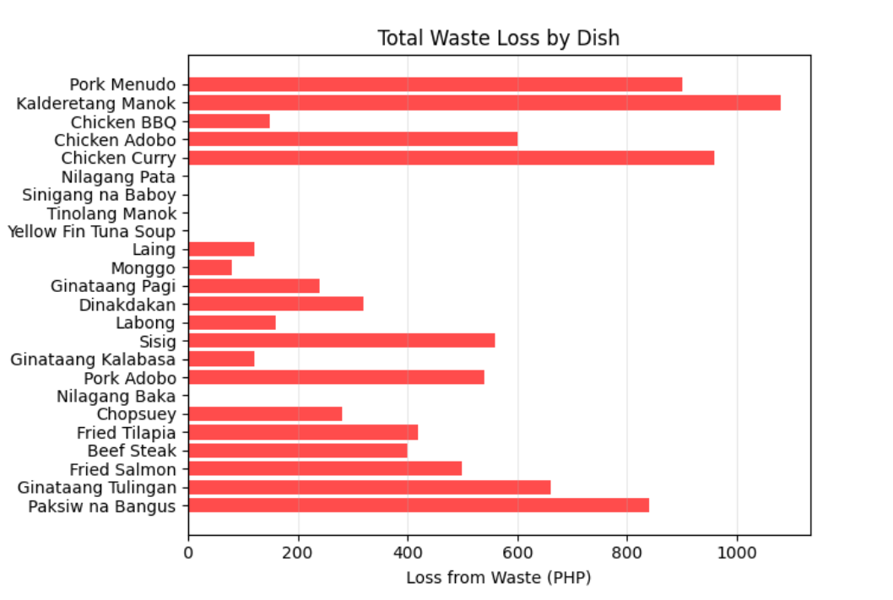
Studio Shodwe
Home
Profile
Our Contact
Total Waste Loss by Dish

Slide 14
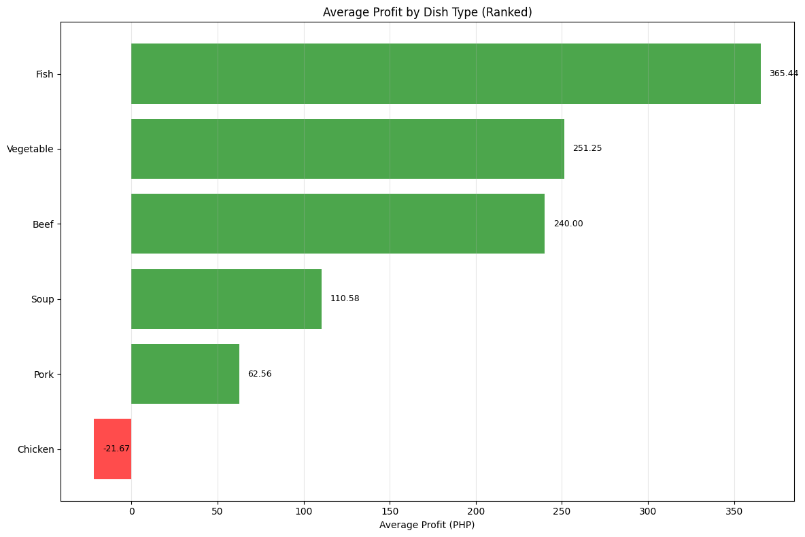
Studio Shodwe
Home
Profile
Our Contact
Mean Profit per Dish Category

Slide 15
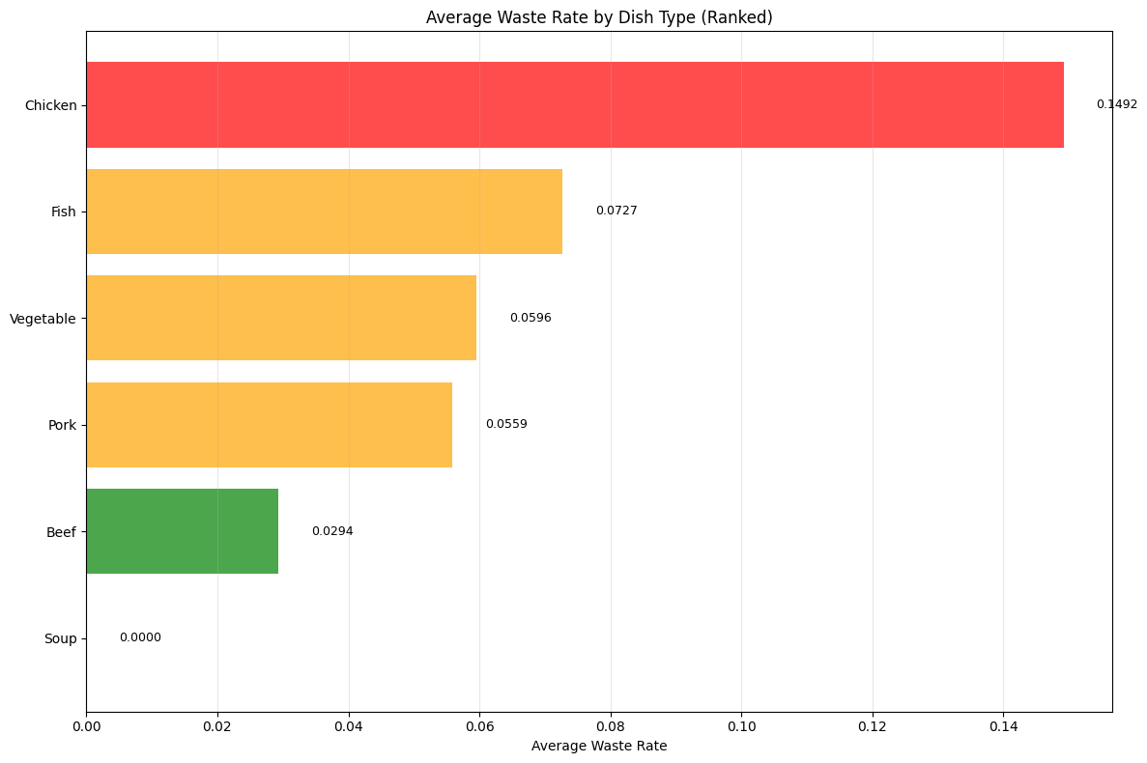
Studio Shodwe
Home
Profile
Our Contact
Mean Waste Rate by Dish Type

Slide 16
Studio Shodwe
Home
Profile
Our Contact
Pearson Correlation
H₀: No linear correlation (r = 0)
H₁: Significant linear correlation (r ≠ 0)

Slide 17
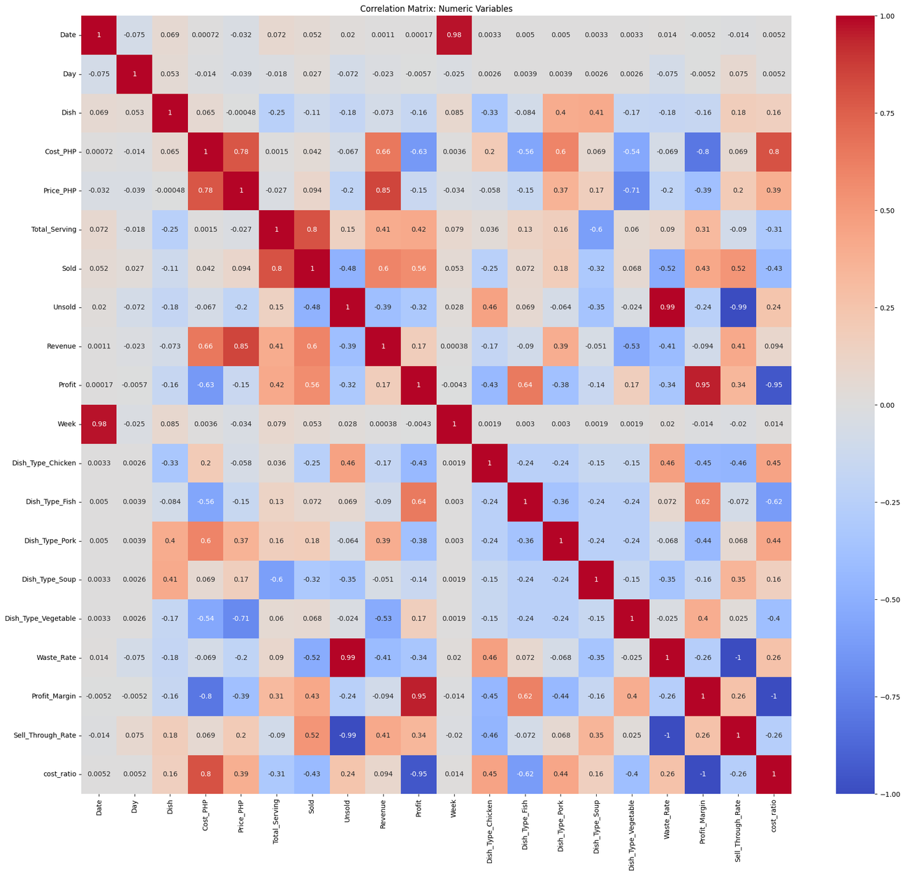

Slide 18
Studio Shodwe
Home
Profile
Our Contact
Strongest Profit Drivers
Profit & Profit Margin: r = 0.947
Profit & Cost Ratio: r = −0.947
Profit & Cost: r = −0.630
Sales Relationships
Servings & Units Sold: r = 0.800
Profit & Units Sold: r = 0.561
Waste Effects
Waste Rate & Unsold: r = 0.995
Profit & Waste Rate: r = −0.337
Dish Category Patterns
Fish → Profit: r = 0.642
Chicken → Profit: r = −0.433
Chicken → Waste Rate: r = 0.464

Slide 19
Studio Shodwe
Home
Profile
Our Contact
Pearson Correlation Heatmap
H₀: No linear correlation (r = 0)
H₁: Significant linear correlation (r ≠ 0)
Multiple significant correlations → Reject H₀
Profitability depends on:
Cost efficiency
Waste control
High-margin dish selection

Slide 20
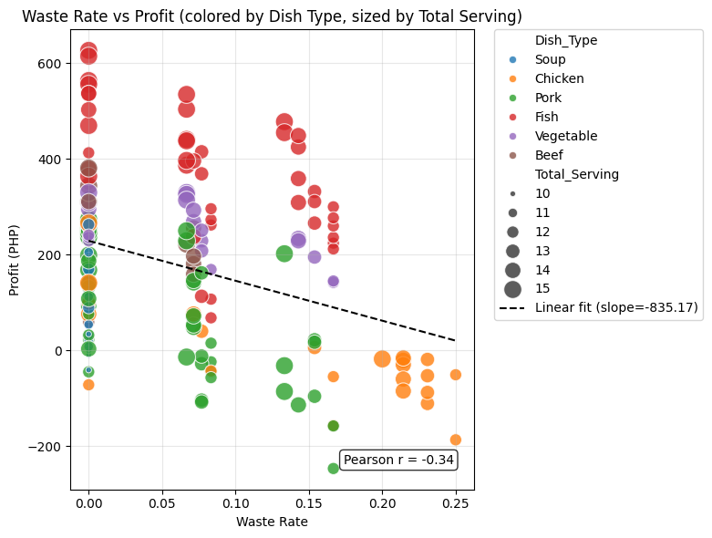
Studio Shodwe
Home
Profile
Our Contact
Profit vs Waste Relationship
H₀: No linear correlation (r = 0)
H₁: Significant linear correlation (r ≠ 0)

Slide 21
Studio Shodwe
Home
Profile
Our Contact
One-way ANOVA
Profit Differences Across Categories
H₀: All category means are equal
H₁: At least one category mean differs

Slide 22
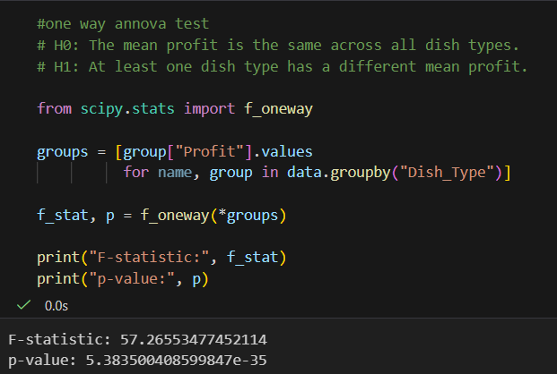
Studio Shodwe
Home
Profile
Our Contact
One-way ANOVA
Profit Differences Across Categories

Slide 23
Studio Shodwe
Home
Profile
Our Contact
One-way ANOVA
Profit Differences Across Categories
H₀: All category means are equal
H₁: At least one category mean differs
Results
F = 57.27
p < 0.001
Reject H₀ → Mean profits significantly differ across categories.

Slide 24
Studio Shodwe
Home
Profile
Our Contact
One-way ANOVA
Profit Differences Across Categories
Profit Ranking (Highest to Lowest)
Fish → Highest average profit
Vegetable & Soup → Strong, stable returns
Pork → Moderate profitability
Chicken → Lowest mean profit; occasional negative returns
Interpretation
Profitability strongly influenced by dish category
Differences likely driven by:
Ingredient cost structure
Demand stability
Waste sensitivity

Slide 25
Studio Shodwe
Home
Profile
Our Contact
Synthesis of Findings
  Profitability is unevenly distributed and driven by high-margin categories.
  Chicken dishes → Highest waste (~15%) and lowest mean profit.
  Soup dishes → 0% waste, stable and predictable demand.
  Category differences are statistically significant (ANOVA: F = 57.27, p < 0.001).
  Pearson correlation confirms key drivers:
    Profit & Margin → r = 0.947
    Profit & Cost Ratio → r = −0.947
    Profit & Waste Rate → r = −0.337
  Overall Implication
  Repeating menu systems generate measurable financial patterns.
  Strategic optimization:
    Prioritize Fish & Vegetable categories
    Control high-waste, low-margin items (Chicken)
    Maintain stable performers (Soup)

Slide 26
Studio Shodwe
Home
Profile
Our Contact
CONCLUSIONS

Slide 27
Studio Shodwe
Home
Profile
Our Contact
  Study Overview
    30 days of production & sales data
    Evaluated profitability and waste patterns in a repeating menu system
  Key Findings
    Fish & Vegetable dishes → Highest profits (revenue drivers)
    Soup dishes → 0% waste, operational stabilizers
    Chicken dishes → Highest waste (~15%), lowest profitability
  Statistical Evidence
    ANOVA: Significant profit differences (F = 57.27, p < 0.001)
    Pearson: Profit negatively related to waste (r = −0.337)

Slide 28
Studio Shodwe
Home
Profile
Our Contact
THANK YOU

